Slide 1
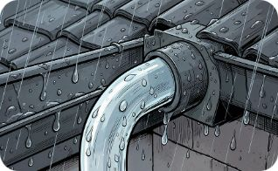
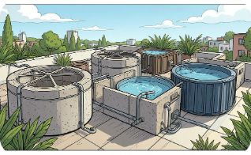
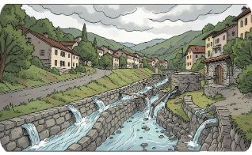

Slide 11 — Layers 1 & 2: Catch and Store
Rooftop Harvesting
Modular Storage
Road & Terrace Channels
Above‑ground or semi‑buried tanks (ferrocement, HDPE, flexi‑tanks) sized for terraces and rooftops — installed without blasting.
First‑flush filters, guttering upgrades, and rooftop sky‑tanks capture high‑quality runoff before street mixing.
Guided runoff channels collect street and terrace flow to local storage or recharge points, reducing uncontrolled erosion.
Speaker note: Emphasize low‑impact installs and rapid modular deployment. Show examples to municipal engineers.

Slide 2
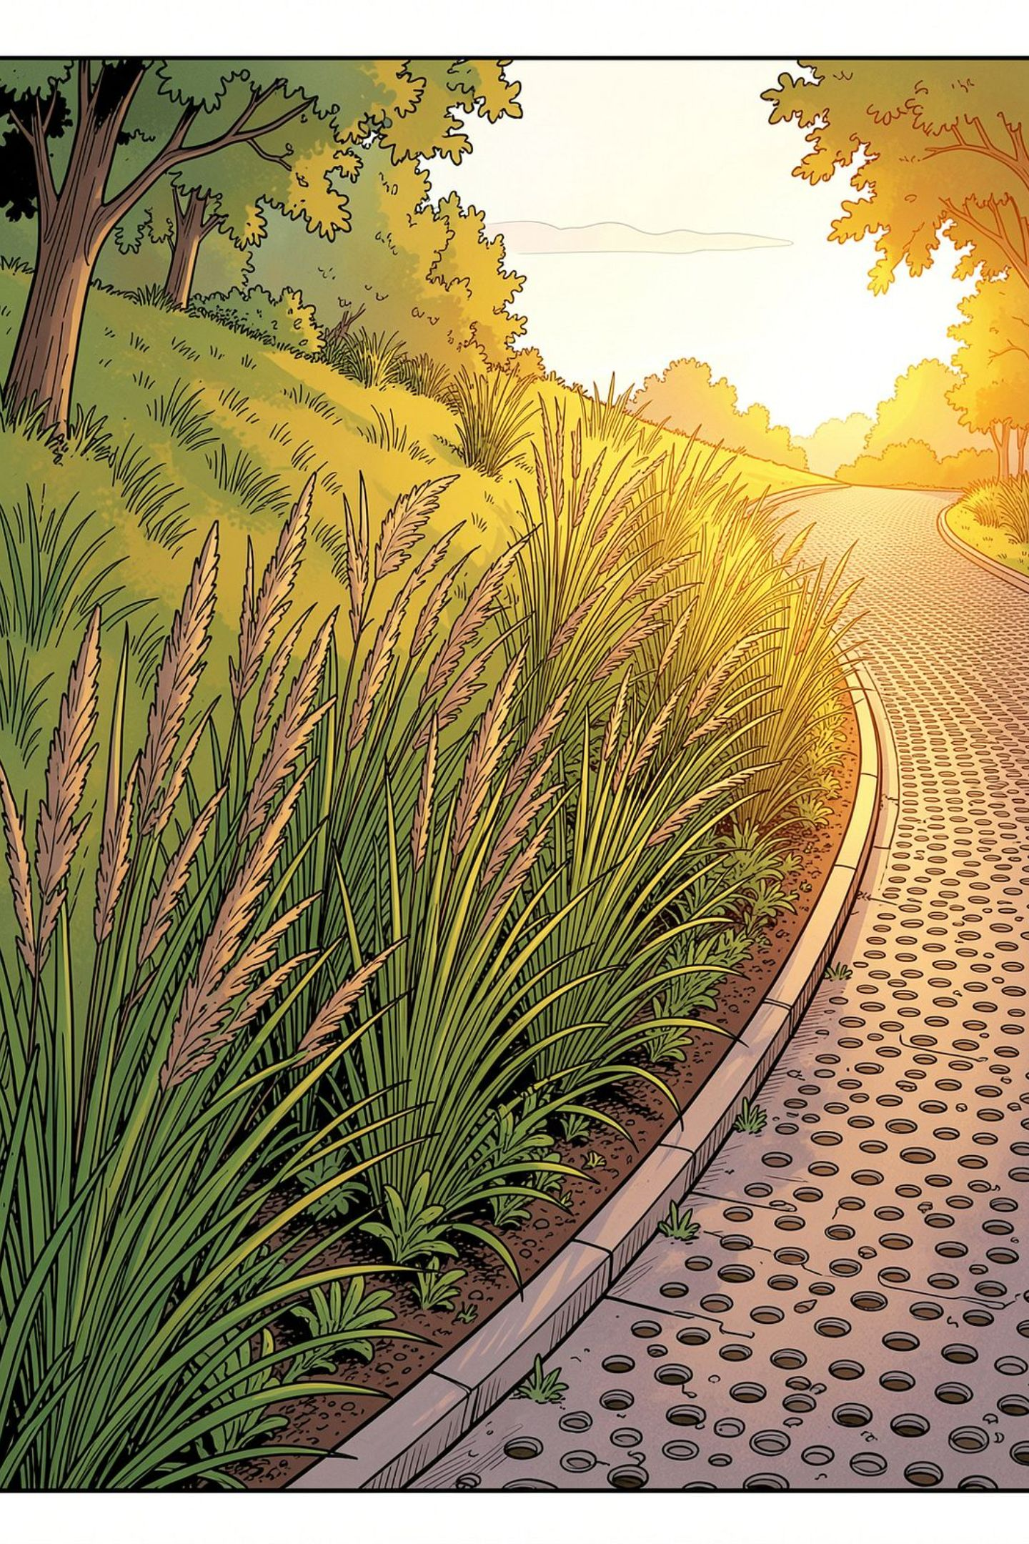




Slide 12 — Layers 3 & 4: Recharge and Reuse / Smart
Permeable Pavements
Drilled Recharge Wells
Reduce surface runoff — let monsoon water infiltrate naturally into the near‑surface aquifer.
Targeted in spring‑shed zones to push water into fractured rock layers where appropriate permits exist.
Decentralized Greywater (Reed Bed)
Reuse Pathways
Simple reed‑bed treatment for household greywater reuse (gardens, flushing) — low O&M.
Greywater → garden irrigation / toilet flushing; treated overflow → recharge or storage.
IoT & App
Tanks and spring sensors, app alerts, tanker scheduling, and tiered pricing signals for demand management.
Speaker note: Clarify permitting for recharge wells and maintenance needs for reed beds; highlight low‑tech reliability.

Slide 3

Slide 13 — Innovation Highlights
Key innovations and the constraints they solve.
Innovation | Constraint addressed
Modular no‑blasting storage (ferrocement, flexi) | Eliminates need for rock blasting; installs on terraces/rooftops
Gravity‑fed distribution networks | Reduces uphill pumping and energy use
Community "water bank" model | Fair allocation and reduced tanker dependency
Solar‑assisted residual lift | Provides power for unavoidable lifts with low carbon footprint
Data‑driven leak detection & scheduling | Prevents losses, optimizes tanker routes and pricing signals
Speaker note: Use real examples when possible; connect each innovation to procurement and ops teams.

Slide 4
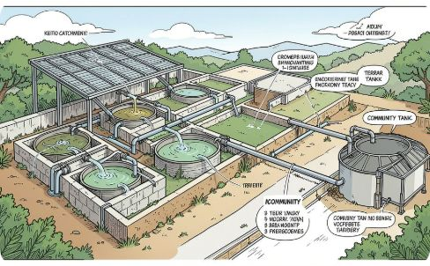
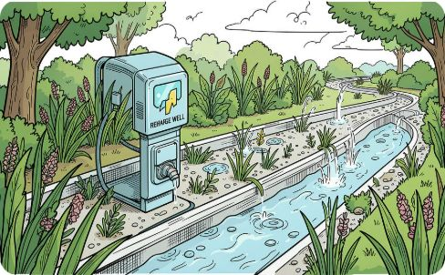

Slide 14 — Step 4: Prototype (Pilot Design)
Design Thinking progress: Empathize → Define → Ideate → Prototype → Test → Implement
Ward pilot: ~100 households. Components shown in layout:
Catchment & Storage
Recharge Points
Clustered rooftop tanks + one shared terrace tank per lane; first‑flush modules included.
Bioswales and drilled recharge wells located at low‑points in the spring‑shed.
Speaker note: Walk through flows in the diagram, showing seasonal differences and maintenance access.

Slide 5
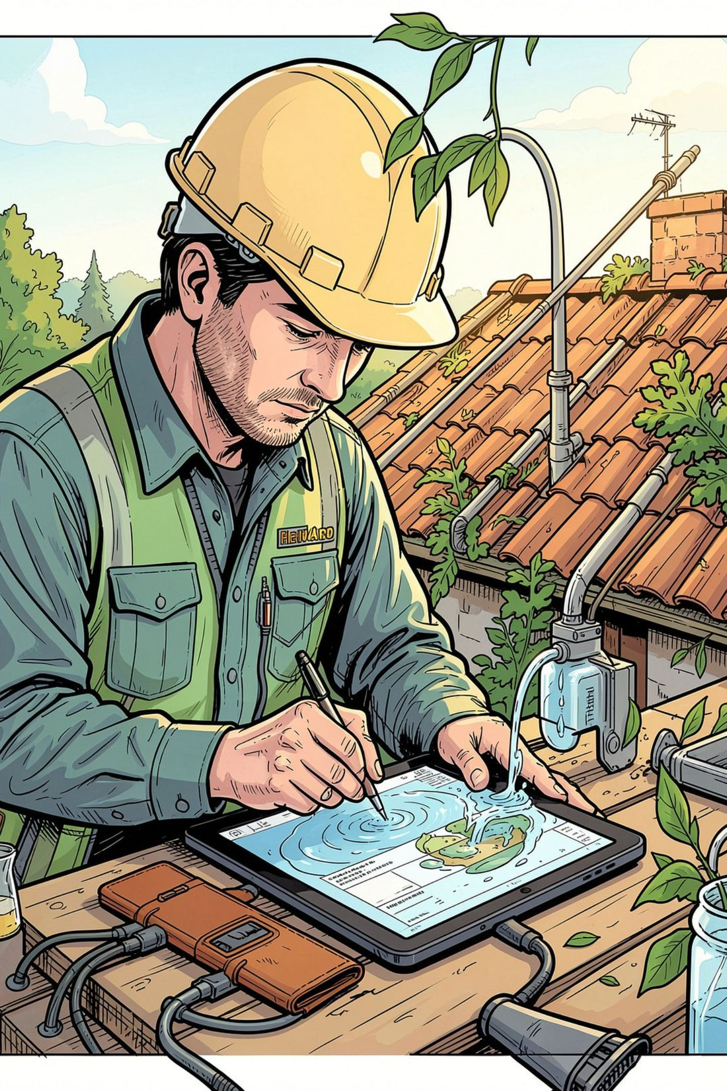

Slide 15 — Step 4: Prototype (Cost & Sizing)
Harvest formula (per household): Roof area × Seasonal rainfall × 0.8 (runoff coefficient)
Worked example
100 m² roof × 800 mm monsoon × 0.8 = 64,000 L harvested per monsoon (64 kL)
Rough BOQ & Cost
1 × 10 kL terrace tank (ferrocement) — capital: $900
1 × 1 kL rooftop HDPE — capital: $120
First‑flush & gutters per house — $60
Recharge well (shared) — $1,200
Estimated capital per household (shared allocations): ~ $350–$600
Speaker note: Clarify locality pricing variance; present these as order‑of‑magnitude estimates for budgeting.

Slide 6
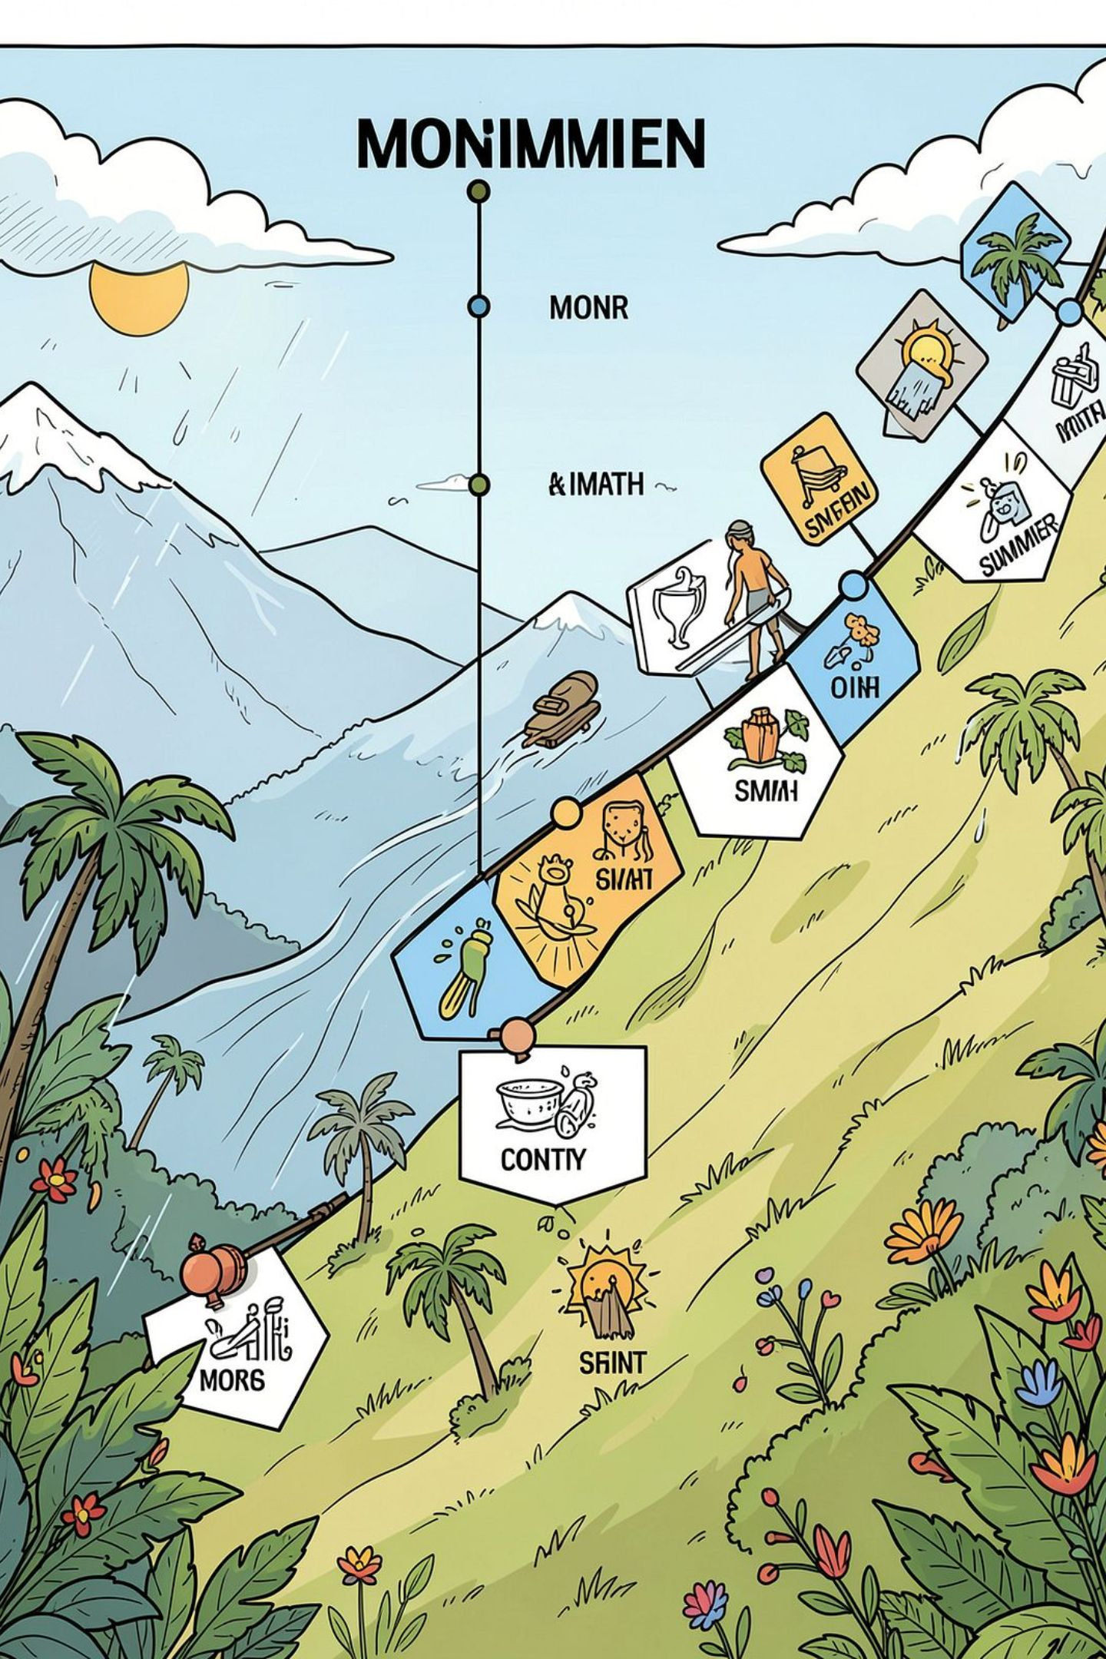

Slide 16 — Step 5: Test (Pilot Plan)
Design Thinking progress: Prototype → Test → Implement
Pilot timeline
Success metrics
Month 0–2: Install before monsoon
Monsoon (3 months): Monitor harvest & recharge
Post‑monsoon to summer (4 months): Measure storage performance
Litres harvested per monsoon (kL)
Days of household shortage reduced
Pumping energy saved (kWh)
Cost per kL delivered
User satisfaction (survey score)
Speaker note: Emphasize data collection cadence (daily tank levels, weekly surveys, IoT health checks).

Slide 7
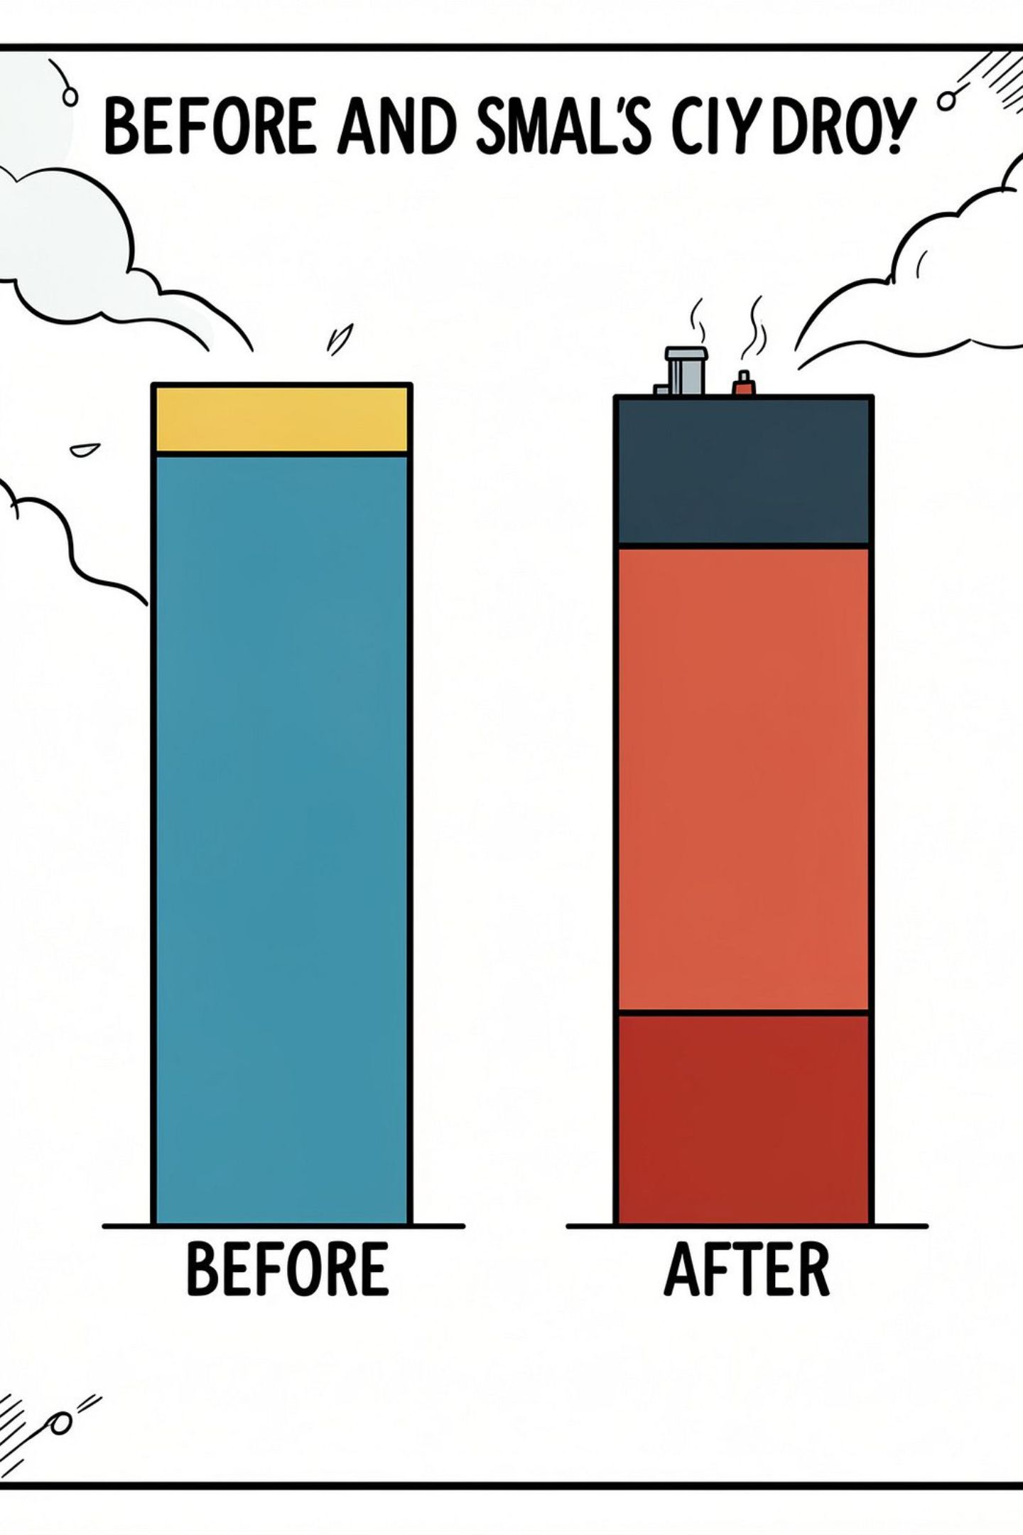
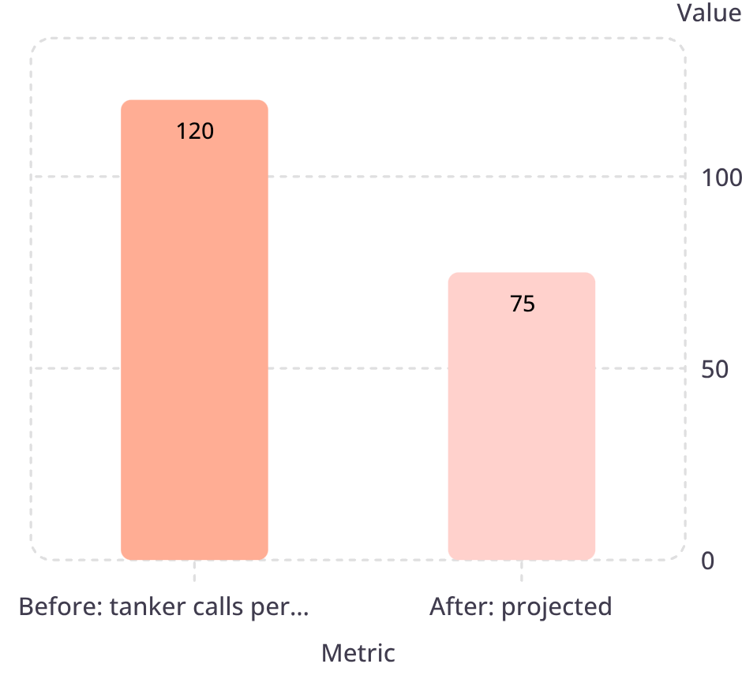

Slide 17 — Step 5: Test (Feedback & Results)
Feedback loop: collect → analyze → refine → redeploy.
01
Collect
IoT tank logs, manual level checks, user surveys, tanker receipts.
02
Analyze
Compare harvest vs need; identify leaks and behavioral gaps.
03
Refine
Expected result: 30–40% reduction in tanker dependence for pilot area.
Adjust tank sizing, recharge placements, pricing signals.
Speaker note: Present real pilot data if available; otherwise explain assumptions behind the projection.

Slide 8
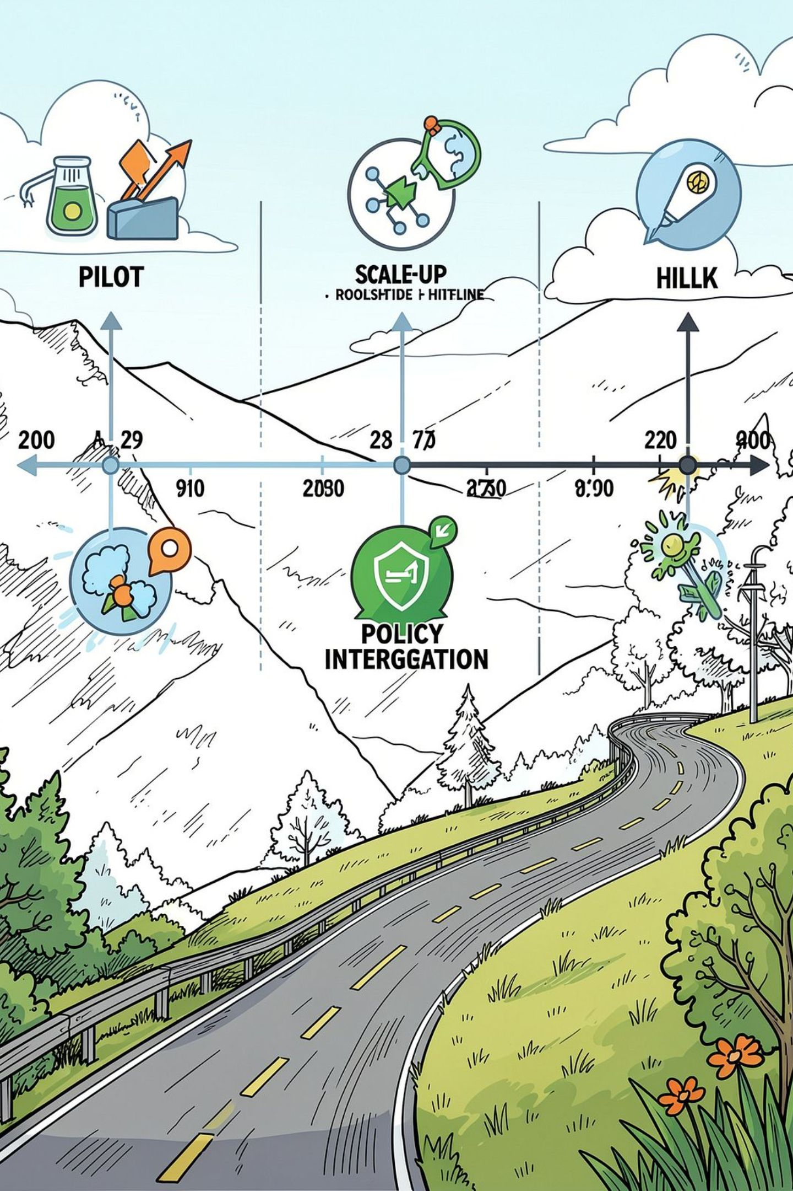
Slide 18 — Step 6: Implement (Roadmap)
Design Thinking progress: Test → Implement
1
Phase 1 — Pilot (6–12 months)
Validate tech, O&M, community model, and unit costs in one ward.
2
Phase 2 — Town‑wide Scale (12–36 months)
Roll out modular tanks, recharge network, and IoT across wards with standardized procurement.
3
Phase 3 — Policy & Replication (36–60 months)
Integrate into municipal water plans, secure funding streams, replicate in other hill towns.
Speaker note: Discuss gating criteria for phase progression and KPIs required to unlock funding for scale.

Slide 9




Slide 19 — Step 6: Implement (Stakeholders & Funding)
Municipality / Water Board
Funding & Maintenance
Sources: government schemes, CSR, targeted water cess, micro‑contributions
Service model: municipal + community O&M contracts; local technicians
Revenue tools: tiered pricing, water bank credits, micro‑insurance for tanks
Approvals, co‑funding, integration with distribution networks.
Panchayat & Residents
Site access, shared maintenance, community water bank governance.
NGOs & Local Contractors
Mobilization, training, reed bed installs, and social engagement.
Speaker note: Emphasize blended finance and local ownership; outline simple O&M checklist and training plan.

Slide 10
Slide 20 — Impact & Risks
Benefits aligned to UN SDGs and key risks with mitigations.
Impact | SDG link | Metric
Improved access to safe water | SDG 6 | kL harvested / household
Resilient, compact hill towns | SDG 11 | Days shortage reduced
Energy & emissions reduced | SDG 13 | kWh saved; solar lifts deployed
Risk | Mitigation
Landslide / geotechnical risk | Site screening, avoid heavy excavation, favor lightweight tanks, geotechnical review
Tank contamination | First‑flush, sealed tanks, periodic sampling, community hygiene training
Low adoption | Community water bank, transparent allocations, incentives and local champions
O&M lapses | Municipal + local contractor contracts, simple manuals, mobile alerts for maintenance
Monsoon variability | Increase storage redundancy, prioritize recharge to buffer dry years, diversify funding
Speaker note: Close by tying impact metrics to municipal KPIs and funding triggers; invite questions on replication requirements.

